Slide 1
Teen Suicide in 2020
Parent Straight Talk – jill mcmahon

Slide 2
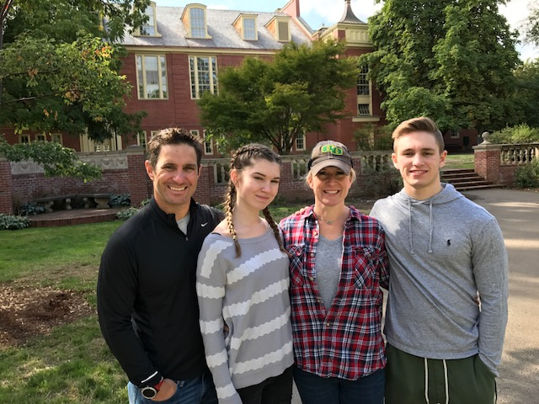
GO DUCKS!

Slide 3
Freshman are Entering College with the Highest Rate of Anxiety Ever. Why?
Fear of being far from home
Independence, adjustment
The Rescuing Parent – didn’t do your child a service after all. Not having the survival skills needed to get by.
Social Media Glamour Shots – “life is GREAT here!”

Slide 4
How Can we do our Part in Keeping Anxiety and Inferiority at Bay?
REAL EXPECTATIONS
Refuse to Compete with the Jones
Let Them Fail – a lesson we all should have learned in the 4th grade.
Overparenting: 5 Recovery Step From a Former Stanford Dean

Slide 5
Despite our Best Efforts, Sometimes “IT” Happens.

Slide 6
Suicide in Arizona – What Does it Really Look Like?
Top 18 in the Country
Recent Increase – 2nd leading cause, ages 15-34*
Teen Suicides have increased 25% since 2016 **
Adult Stats v. Teen Stats*
35.7% - Highest rate- Middle Aged (45-64)
13.25% - Youth (15-24)
*American Association of Suicidology -2017 report
*Americas Health Rankings – 2019 report

Slide 7
It’s Most Likely Not About Us

Slide 8
Signs of Teen Depression
Risk Factors:
Mental Illness
Substance Use
Firearms in the Household
Previous Attempts
Exposure to friend/family suicide
Low Self-esteem - hopelessness- no sense of purpose
Isolation
Protective Factors:
Family and School Connectedness
Academic Achievement
Self-esteem

Slide 9
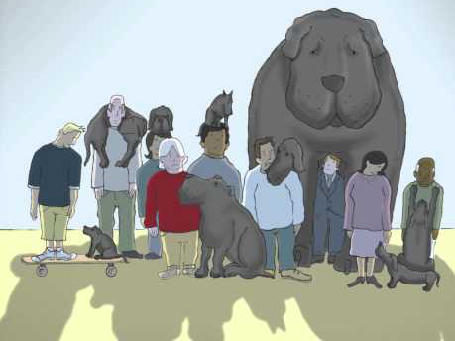
Is There a Black Dog in Your Family?

Slide 10
What you may see….
Feeling more irritable or angry than usual
Weight gain or loss, change in appetite
Having trouble sleeping, or sleeping too much
Physical feeling of restlessness
Not having energy
Feeling worthless or guilty for no clear reason
Can’t concentrate or make decisions
Comments like: I just want it to stop. I don’t want to be here anymore. I just can’t do this anymore.

Slide 11
Teens are Tricky
Signs are NOT Always Obvious
Brain Development in the 21st Century
Born With a Media Computer Chip – we are outsiders in their world. Embrace media. Learn their language.

Slide 12
When a Friend is Hurting…
The Giver – always available 24/7
Feeling Desperate to Help
Emotional Burnout at a Young Age
Aimee’s Story

Slide 13
Teaching Resiliency
Help Your Children Feel Confident in Their Own Strength
Let Them Fail and Pull Themselves Up
Be inspiring, encouraging – without coddling.

Slide 14
Local Resources
Teen Lifeline www.teenlifeline.org 602.248.8336
Buddy Project http://www.buddy-project.org
PSC- Psychological Counseling Services www.pcseearle.com 480.947.5739
Therapy with Heart www.therapywithheart.com 480.888.5380

Slide 15
When the Day Comes to Let Them Go…..
…..feel confident that you’ve done the best you can to clear their path, and teach them how to clean the debris out of the their own way. Know that they might need a refresher course from time to time. They may need our help to MEND what’s been torn….and that mending (not rescuing) provides them hope in themselves. With hope comes LIFE!

Slide 16
Thank you for listening – Jill McMahon, LPC Spring Returns Counseling Services www.jillmcmahoncounseling.com

